Slide 1
Our Journey to the Cloud
Grant Tate

Slide 2
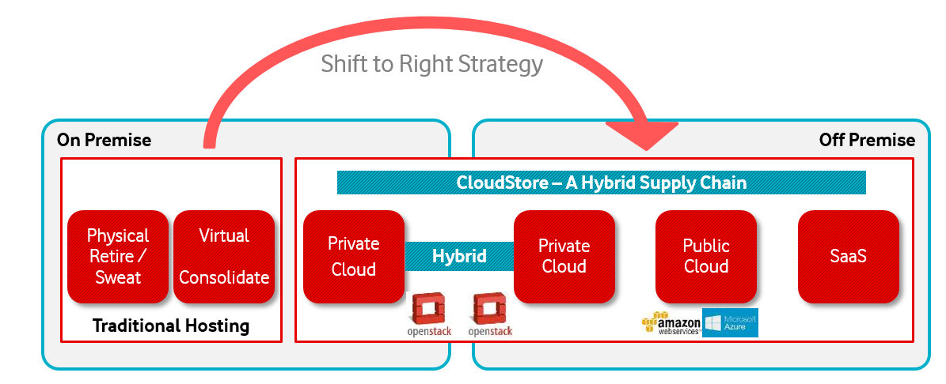
Cloud Vision 2020 | 65% Internal IT workloads running on cloud services
The IT Strategy is to exploit next generation of cloud technology: Infrastructure as a Service (IaaS),
Platform as a Service (PaaS), Software as a Service (SaaS). By 2020, the goal is to have 65% of our
applications in IaaS/PaaS/SaaS.
Notes:
Provided as an input into the process, this helped frame Vodafone’s strategic appetite in relation to cloud and its delivery models

Slide 3
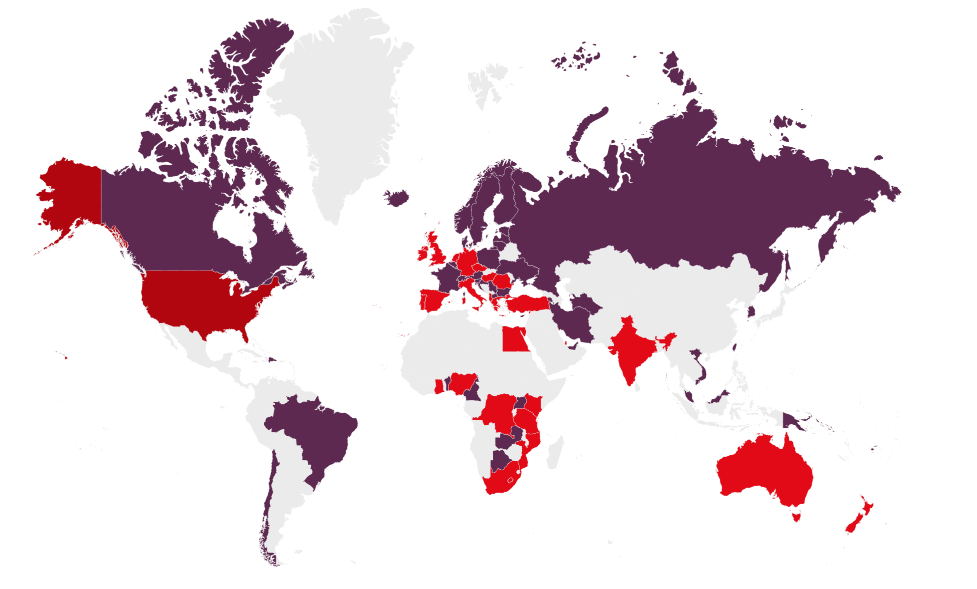
Our Global Footprint
Mobile networks in 26 Countries
Fixed Services in 17 Countries
49 Partner Countries

Slide 4

Our Data Centre footprint today
Broad data centre footprint.
Covers 98 markets in 5 continents.
Over 6 million square feet of space.
Ireland
US
UK
Germany
Turkey
China
Japan
Egypt
Qatar
India
Hong Kong
Nigeria
Dubai
Ghana
Kenya,
Tanzania
Singapore
Vodafone & Vodacom facilities
Australia
New
Zealand
Partner facilities connected to our network
South Africa,
Lesotho

Slide 5
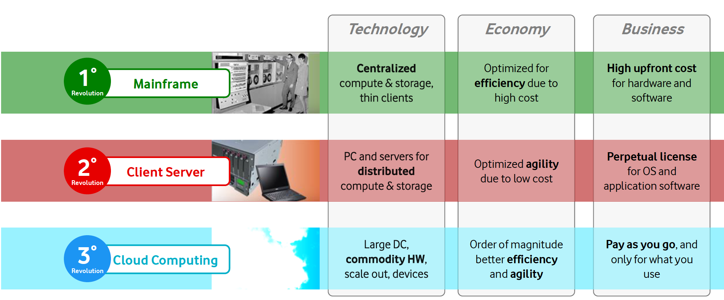
Revolutions in Consumption of Computing

Slide 6
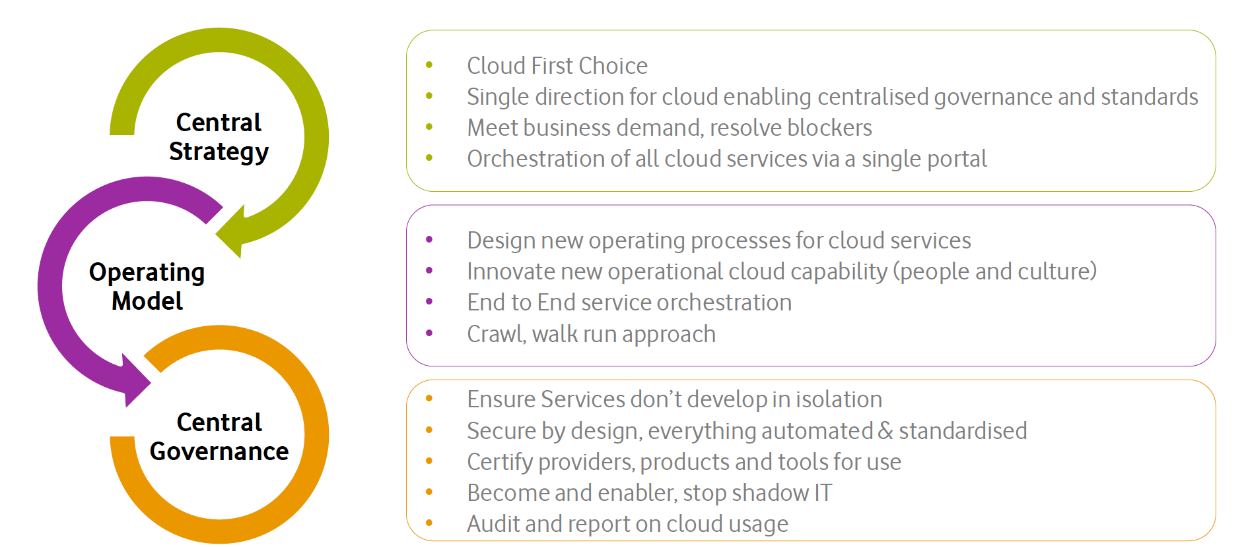
Cloud Strategy

Slide 7
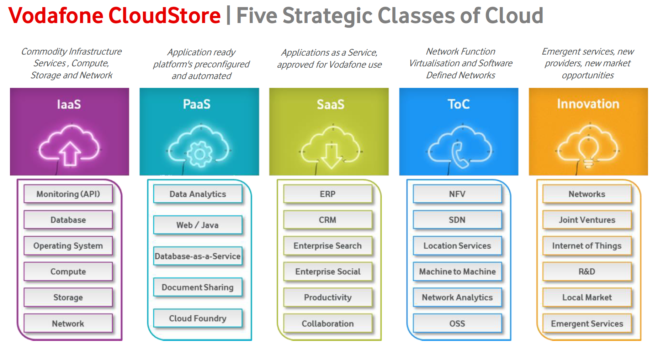
Notes:
TOC Transport Operations Centre
OSS – Operations Support systems
Latency and Failure Resiliency
The cloud applications run in a shared environment, where the load of another tenant can cause variability in the response time. Also, since location of services are not static in the cloud scenarios, a change of a service location from one network to another can also cause latency in the response time. Therefore, as a principle, the cloud applications are designed to handle the latency. Moreover, the infrastructure failures in the cloud are also very common. For example, network congestions, request contentions, I/O saturation in storage systems, software and hardware failures etc... These failures do occur time to time, therefore applications must be designed to handle failures gracefully, and automatically recover from failures. A popular design pattern that is used to address latency and failure is request/response queue, where requests and responses are stored in queues so that they are not lost. Also, the applications do not block the user experience when the response is slow or when failure occurs. Rather, they indicate that the request is in progress and let the user continue to use other functions of the application.

Slide 8
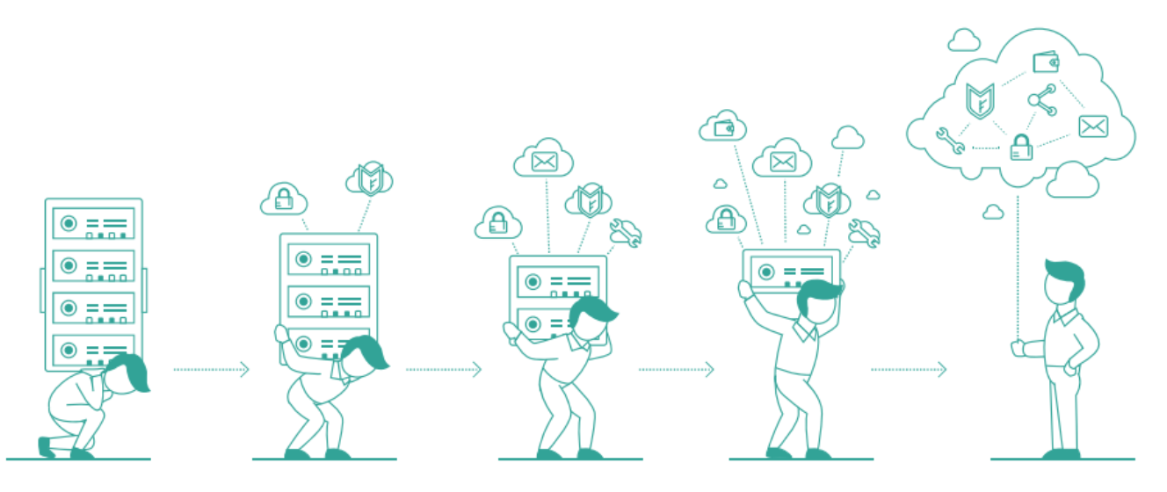
Application Maturity: Enabling Cloud Adoption
Legacy Applications
Virtulised
Cloud Ready
Cloud Native
Legacy applications tied to Physical Infrastructure
Applications that are Supported and Licensed for Virtualization
Infrastructure and operations service wrap offering some Cloud Benefits
Designed for the cloud from the ground up

Slide 9
Business Maturity: The Benefits Journey
Legacy
Cloud Native
Virtualised
Cloud Ready
Benefit
Cloud Brokerage
Traditional Hardware
Converged
Cloud
Business Availability Assured By Infrastructure
App-driven
Traditional Operating Model
Agile
Traditional Application Architecture
Modern
Notes:
demands, devices, applications, storage, servers, networks, security, architectures
Security & Multi-Tenancy
In the traditional applications, developers assume that the network is relatively secure behind the firewall protected datacenter. Therefore, they do not encrypt the application communication between different tiers and with the database. In the cloud environment, application components are hosted across different networks. They are in multi-tenant environment, and infrastructure is managed by number of third parties. Therefore, it is mandatory to encrypt all communication in the cloud applications. Three guiding principles are followed in cloud application architecture to secure applications and data. They are: secure and encrypt data in transit, secure and encrypt data at rest, and control all API access.

Slide 10
Organisational Maturity: DevOps or bust
DevOps
App Development
App Maintenance
App Operations
Infra Management
Infra Operations
Notes:
DevOps is the combination of cultural philosophies, practices, and tools that increases an organization's ability to deliver applications and services at high velocity: evolving and improving products at a faster pace than organizations using traditional software development and infrastructure management processes.

Slide 11




Network conversion to Cloud Native
Right First Time
Channels
Contact Centre Operations
Retail Operations & Logistics
Customer Relationship Management,
Billing and
Commercial Order Management
Innovation Hotspot
Customer
Management
HR, Finance & Supply-Chain
Service
Assurance
Charging & Policy Management
Service
Orchestration
Systems of Record
SDN/NFV disrupts Fulfilment
Big Data and Real-time Analytics
Analytics &
Intelligence
Service
Management
Business Management
Security
BIG DATA
SDN/NFV
Resource
Fault &
Performance
Resource Inventory
Resource
Activation &
Configuration
Systems of Record
SDN/NFV disrupts Resource
Management
IT and Network Converge
Orchestration & Automation
Other Business
Apps
Resource
Management
SDN/NFV
Automation
Notes:
Ensure that networks are capable of providing for both Private and Public cloud with the expected performance
Ensure that the networks are secure and able to provide for for our data requirements and automated resource mangement requirements

Slide 12


Drive to Cloud Now
Faster delivery and better customer experiences
1st Priority
Channels
Contact Centre Operations
Retail Operations & Logistics
Customer Relationship Management,
Billing and
Commercial Order Management
Innovation Hotspot
Customer
Management
HR, Finance & Supply-Chain
Systems of
Innovation
Customer Experience
driven Innovation,
and Analytics & Intelligence
Service
Assurance
Charging & Policy Management
Service
Orchestration
Vodafone
Online
Agile
Factory
Analytics &
Intelligence
Service
Management
Business Management
Security
Other Business
Apps
Resource
Fault &
Performance
Resource Inventory
Resource
Activation &
Configuration
Resource
Management
Systems of Innovation:
Analytics & Intelligence
Innovation driven by moving traditional capabilities from Customer, Service & Resource Management systems of record to disruptive analytic capabilities – enabling better exploitation monetisation of our data
Notes:
Start first in building the culture, processes and platforms to enable agility and Dev Ops from the beginning, all new channel developments to be on a cloud first basis
Analytics is a major part of our business everything depends on consumer demand, understanding where and when the customer uses what services allows us to prioritise our performance and service provision

Slide 13

Build Solid Foundations
Using cloud to enable stable core customer functions
2nd Priority
Channels
Contact Centre Operations
Retail Operations & Logistics
Customer Relationship Management,
Billing and
Commercial Order Management
Customer
Management
HR, Finance & Supply-Chain
Systems of Differentiation
  Standardisation and Convergence
  Support our converged offerings
  Innovate through SaaS
Service
Assurance
Charging & Policy Management
Service
Orchestration
Analytics &
Intelligence
Service
Management
Business Management
Security
SAAS
Multi-tenanted Cloud
Other Business
Apps
Resource
Fault &
Performance
Resource Inventory
Resource
Activation &
Configuration
Resource
Management

Slide 14
Channels : Omni-Channel
Channels
Contact Centre Operations
Retail Operations & Logistics
Customer Relationship Management,
Billing and
Commercial Order Management
Customer
Management
HR, Finance & Supply-Chain
Service
Assurance
Charging & Policy Management
Service
Orchestration
Service
Management
Analytics &
Intelligence
Business Management
Security
Other Business
Apps
Resource
Fault &
Performance
Resource Inventory
Resource
Activation &
Configuration
Resource
Management

Slide 15
Plan for maturity
The target is Cloud but planned wisely
3rd Priority
Channels
Contact Centre Operations
Retail Operations & Logistics
Customer Relationship Management,
Billing and
Commercial Order Management
Customer
Management
HR, Finance & Supply-Chain
Systems of Record
SDN/NFV disrupts Fulfilment
Big Data and Real-time Analytics
Service
Assurance
Charging & Policy Management
Service
Orchestration
BIG DATA
SDN/NFV
Analytics &
Intelligence
Service
Management
Business Management
Security
Systems of Record
SDN/NFV disrupts Resource
Management
IT and Network Converge
Orchestration & Automation
SDN/NFV
Automation
Other Business
Apps
Resource
Fault &
Performance
Resource Inventory
Resource
Activation &
Configuration
Resource
Management
Systems of Innovation:
Analytics & Intelligence
Innovation driven by moving traditional capabilities from Customer, Service & Resource Management systems of record to disruptive analytic capabilities – enabling better exploitation monetisation of our data

Slide 16
Application Development Patterns
Legacy
Virtualised
Cloud Ready
Cloud Native
Application Behaviours
Legacy
Cloud Ready
Cloud Native
Delivery
Waterfall
DevOps
Agile
Platforms
Physical DC
VMWare DC
Openstack DC
Public Cloud Providers
Deployment Model
Manual
Stack Automated
OS Automated
Operate Model
Manual
Dev Ops/Autonomic
Scripted
DC Services
Traditional
“X”aaS
Notes:
Operating model as well as operations model
Finance model
Security (move right is more default, less exception)
Breakpoint slide for 2.0-2.5 (for KPI measurement)

Slide 17
Application Behaviour Patterns
Legacy
Virtualised / Cloud Ready
Cloud Native
Installation
Manual
Automated/Scripted
DevOps /Autonomic
Architecture style
Monolithic
Modular
API-centric microservices
Service Discovery
Pre-configured
Automatic /Scripted
Autonomous discovery
Capacity/performance
Manually governed
Infrastructure-driven dynamic scaling
Elastic scaling
Transient State
Stateful
Minimised State
Stateless
Geographic Resilience
Single site active
Multiple site active/active
Geographically distributed
Business Continuity
Disaster Recovery Planned
Business Continuity Guaranteed
Licensing
Infra/geo/org bound
Virtual resource bound
Time or transaction/event volume bound
Server deployment
Physical Server
Hypervisor / container
Infrastructure/service
dependence
Type, version and configuration
Type
Interface/protocol standard
Notes:
Operating model as well as operations model
Finance model
Security (move right is more default, less exception)
Breakpoint slide for 2.0-2.5 (for KPI measurement)

Slide 18
How to manage all of this

Slide 19
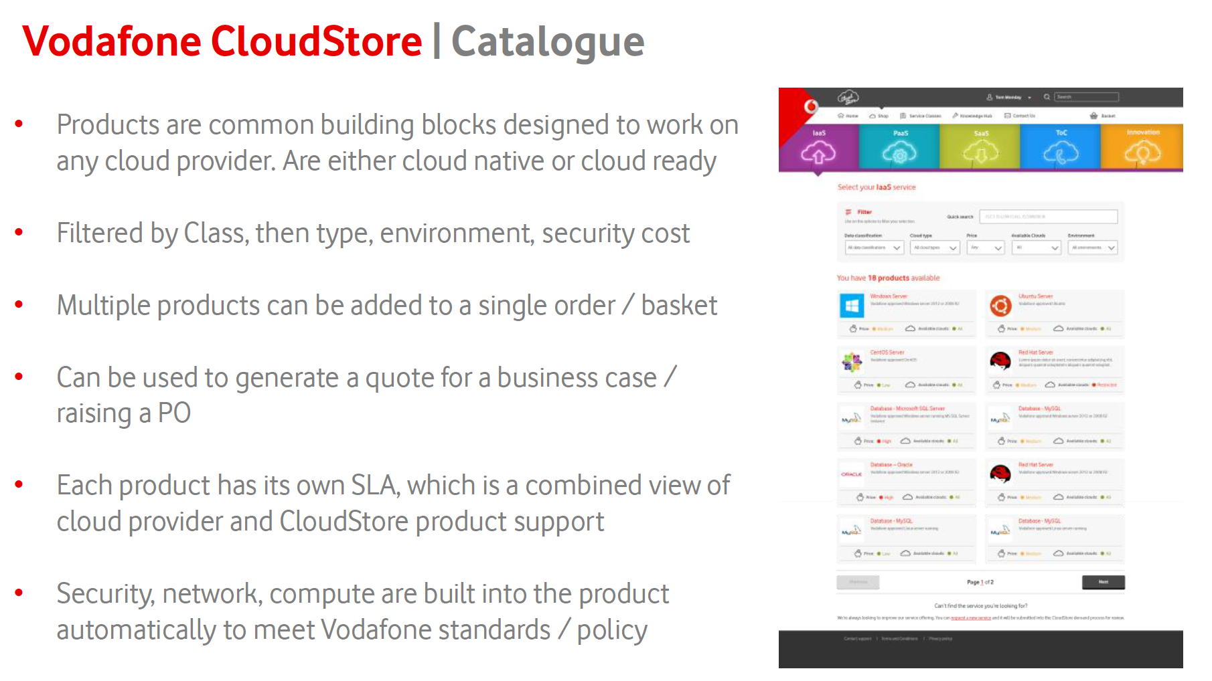

Slide 20
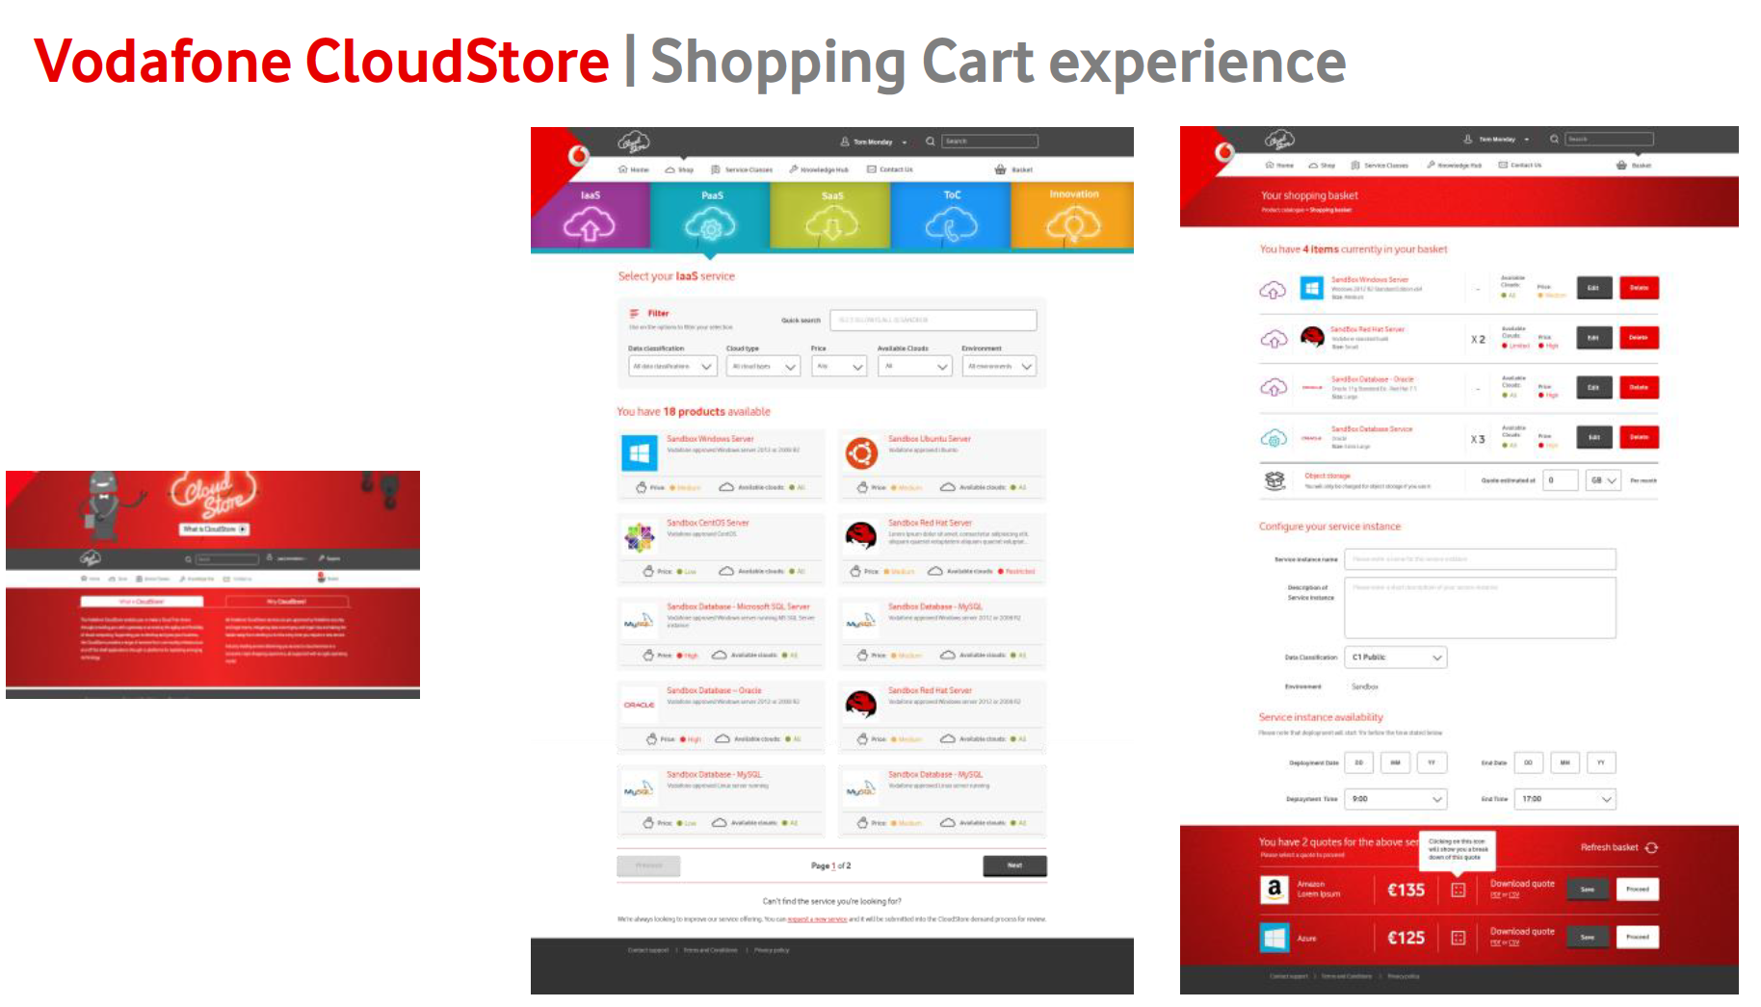

Slide 21
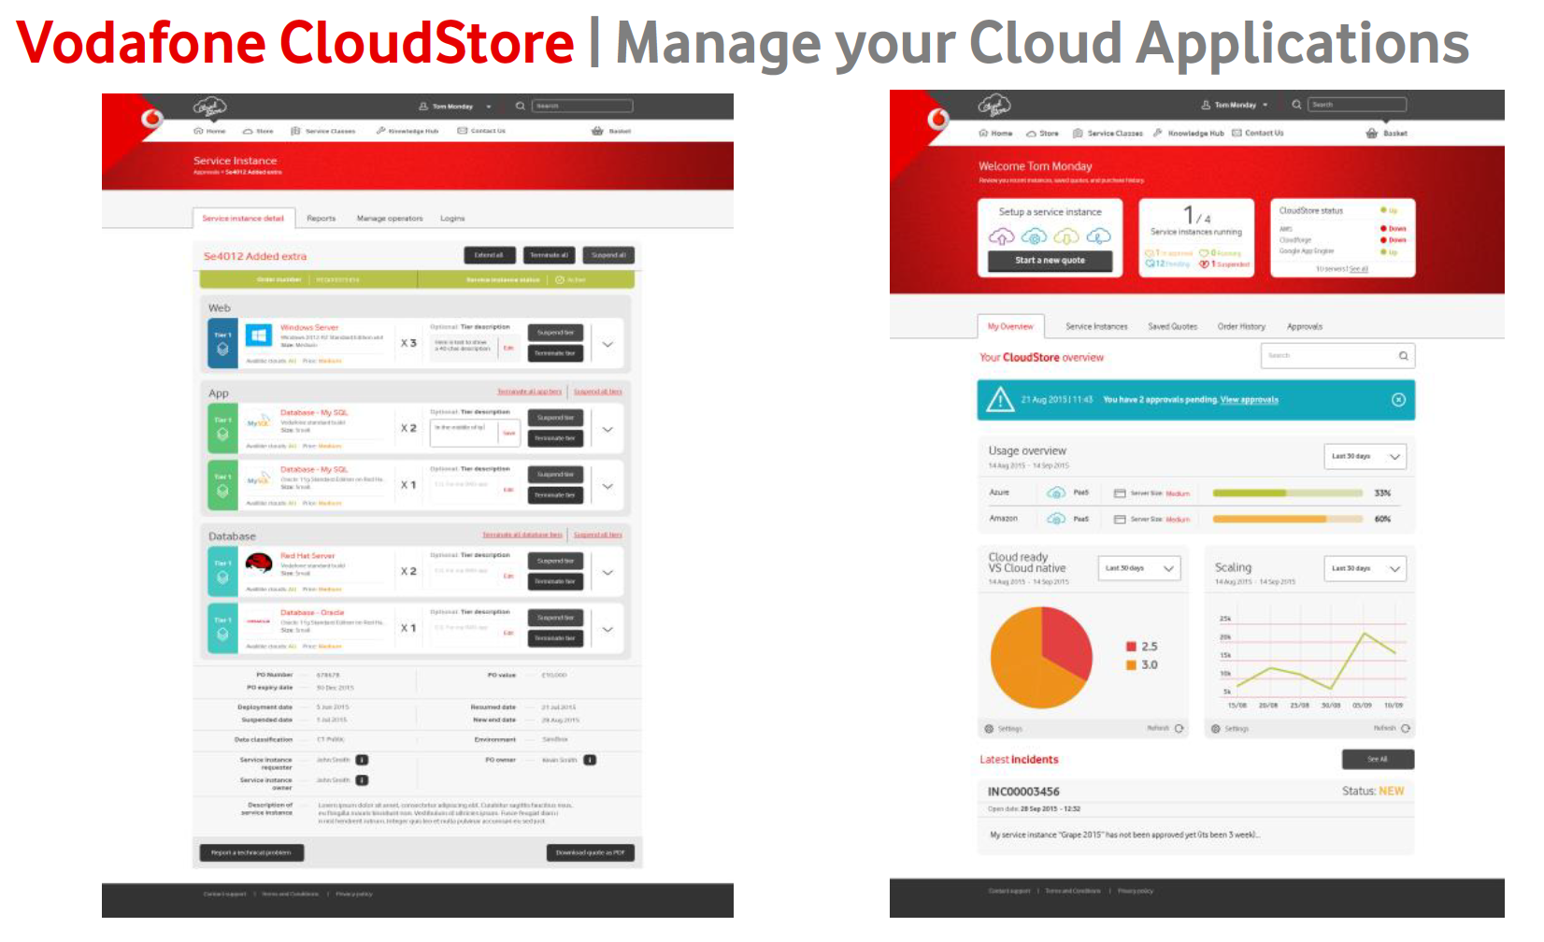

Slide 22
The future is exciting.
Ready?

