Slide 1
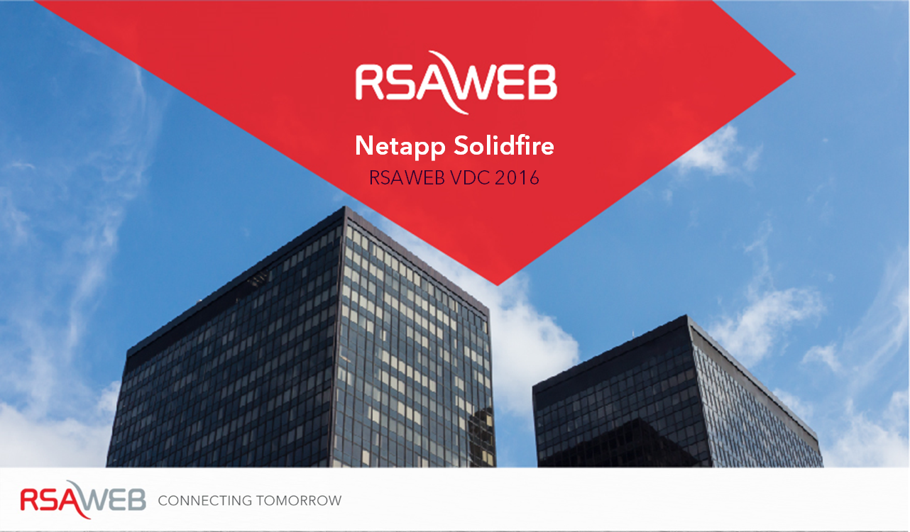
Netapp Solidfire
RSAWEB VDC 2016
CONFIDENTIAL
Notes:
Intro - “hello alexa”

Slide 2
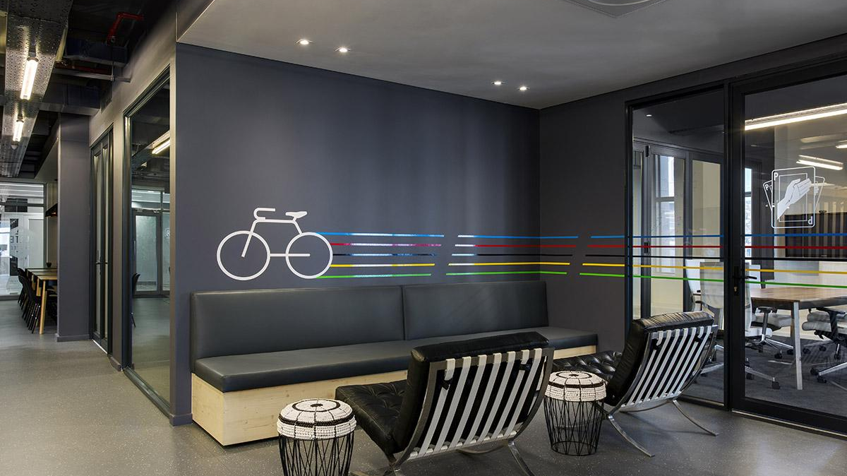
Who we are
CONFIDENTIAL

Slide 3
Who am I
Mark Slingsby - CTO of RSAWEB - @markslingsby
Experience:
  Cloud Computing
  Connectivity
  Enterprise
  Service provider
  Systems
Experience in multiple business types & customers
CONFIDENTIAL

Slide 4
Who we are
Started in 2001, building our first web, DNS & mail systems
Built our first datacentre in 2004
Second DC in 2009
Netapp investment 2009
RSAWEBCloud.com in 2009
Enterprise Cloud & vDC in 2010
MPLS Cloud Network deployed 2011
POP’s deployed in Teraco’s 2011/2012
Solidfire partnership 2015
Expanded CloudConnect to 10Gbps
Further Cloud, Solidfire & Netapp investment 2016
CONFIDENTIAL

Slide 5
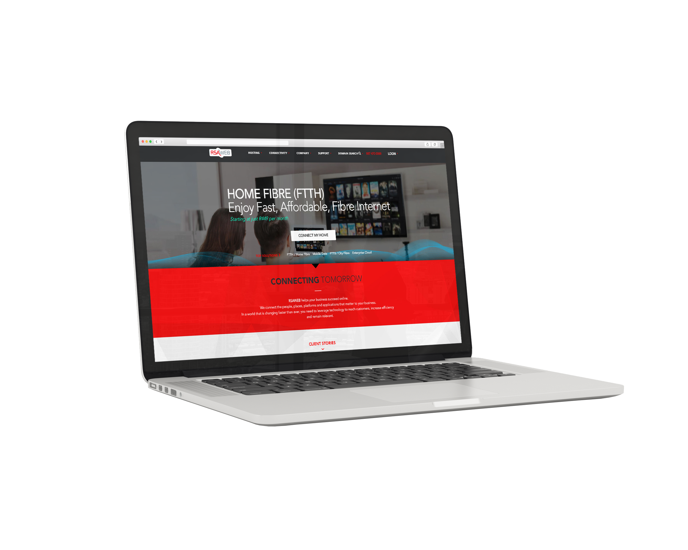
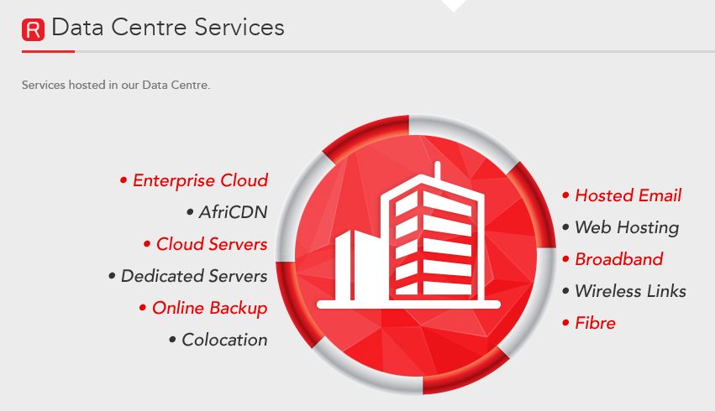
What do we do?
Cloud
Connectivity
Mobile
CONFIDENTIAL

Slide 6
What do we do?
Customer requirements have shaped our strategy
VDC (Enterprise Cloud)
DR as a Service
Cloud Servers & Cloud Services
Large Volume Web Hosting
Managed Cloud Services
Business Connectivity
Enterprise MPLS
ISP & Wholesale Services
CONFIDENTIAL

Slide 7













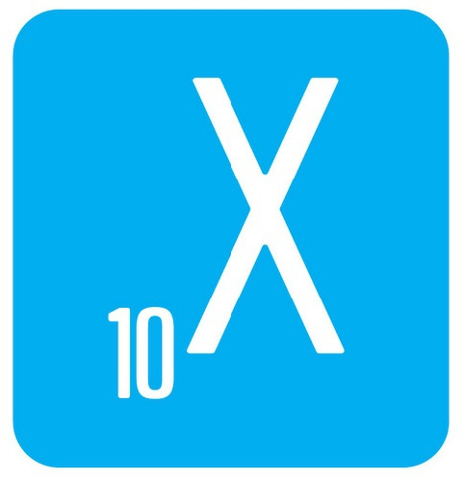








Some of our clients
CONFIDENTIAL
Notes:
Allan

Slide 8
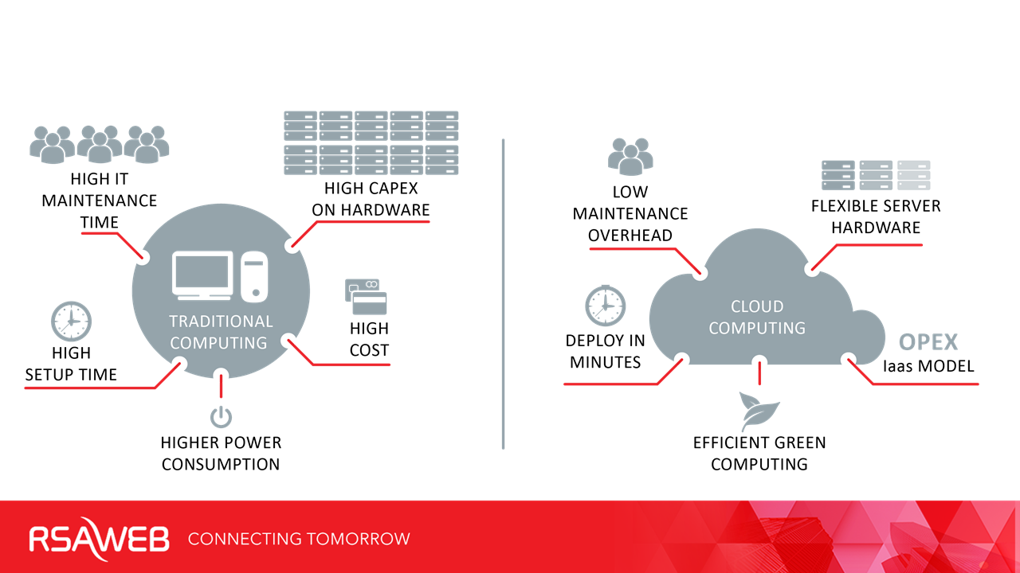
Why Cloud & VDC?
CONFIDENTIAL

Slide 9
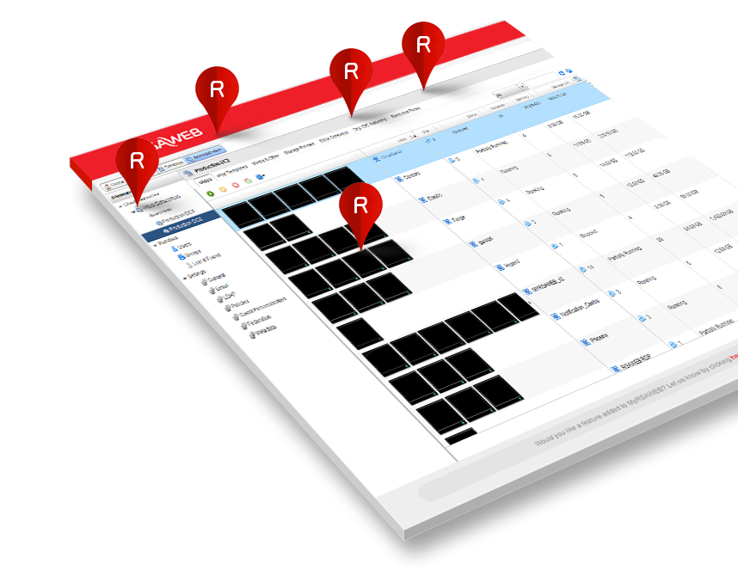
VDC
What does it replace?
→ onsite servers
→ colocation of hardware
→ onsite server room
→ onsite hardware refreshes
→ challenges with storage capacity
→ challenges spending capex
→ free your scare IT skills to focus
Makes IT responsive & efficient
CONFIDENTIAL

Slide 10
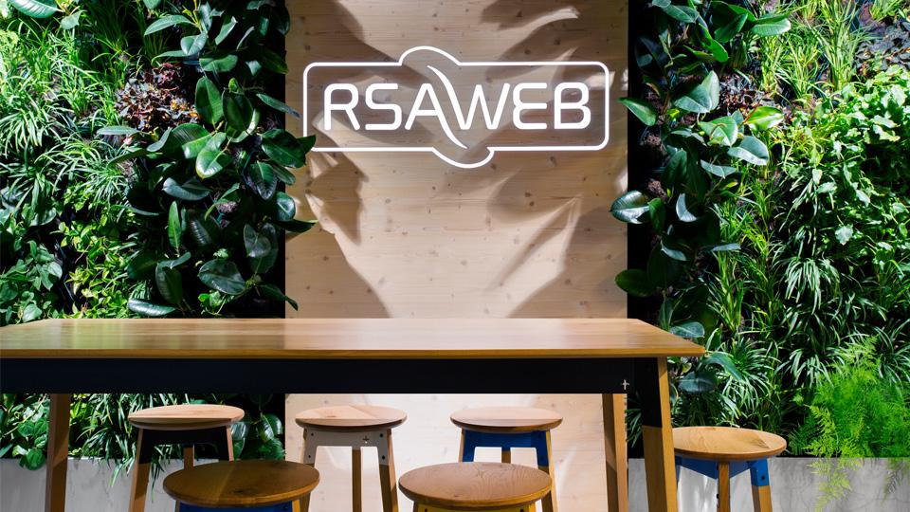
Our Technology
CONFIDENTIAL
Notes:
Mark to talk tech

Slide 11
Enterprise Cloud
(VDC)
Virtual Data Centre.
Replaces your data centre / server room
with an easy online management tool with
all your resources in our VDC control panel.
Flexible. Deploy in minutes.
Highly flexible on demand resources
CONFIDENTIAL

Slide 12

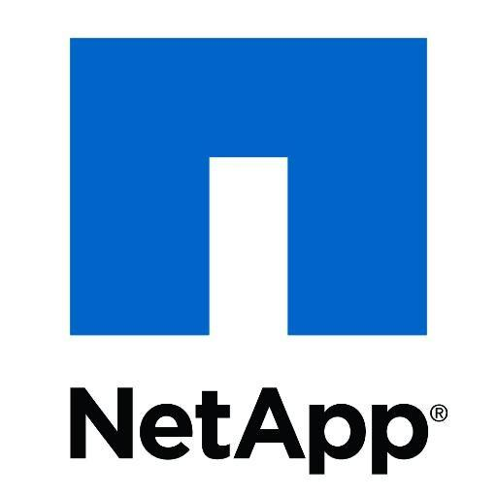




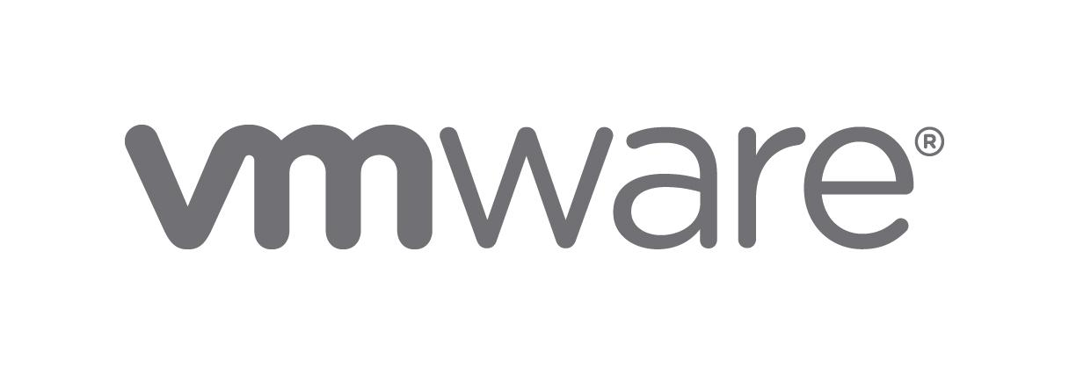
VDC - the stack
CONFIDENTIAL
Notes:
Netapp
Solidfire
VMWare
Aristra
Supermicro
Dell
Shapeblue

Slide 13
Problems we encountered before SF
No guaranteed IOPs
Tiering was possible but hard
Glass ceiling on controllers & shelves
How do you maximise our investment but don’t know when to buy more
Big capex jumps when scaling
Forklift upgrades
Unable to predict what customers we would onboard & their requirements
Traditional NetApp FAS ran out of IOPS before capacity
CONFIDENTIAL

Slide 14
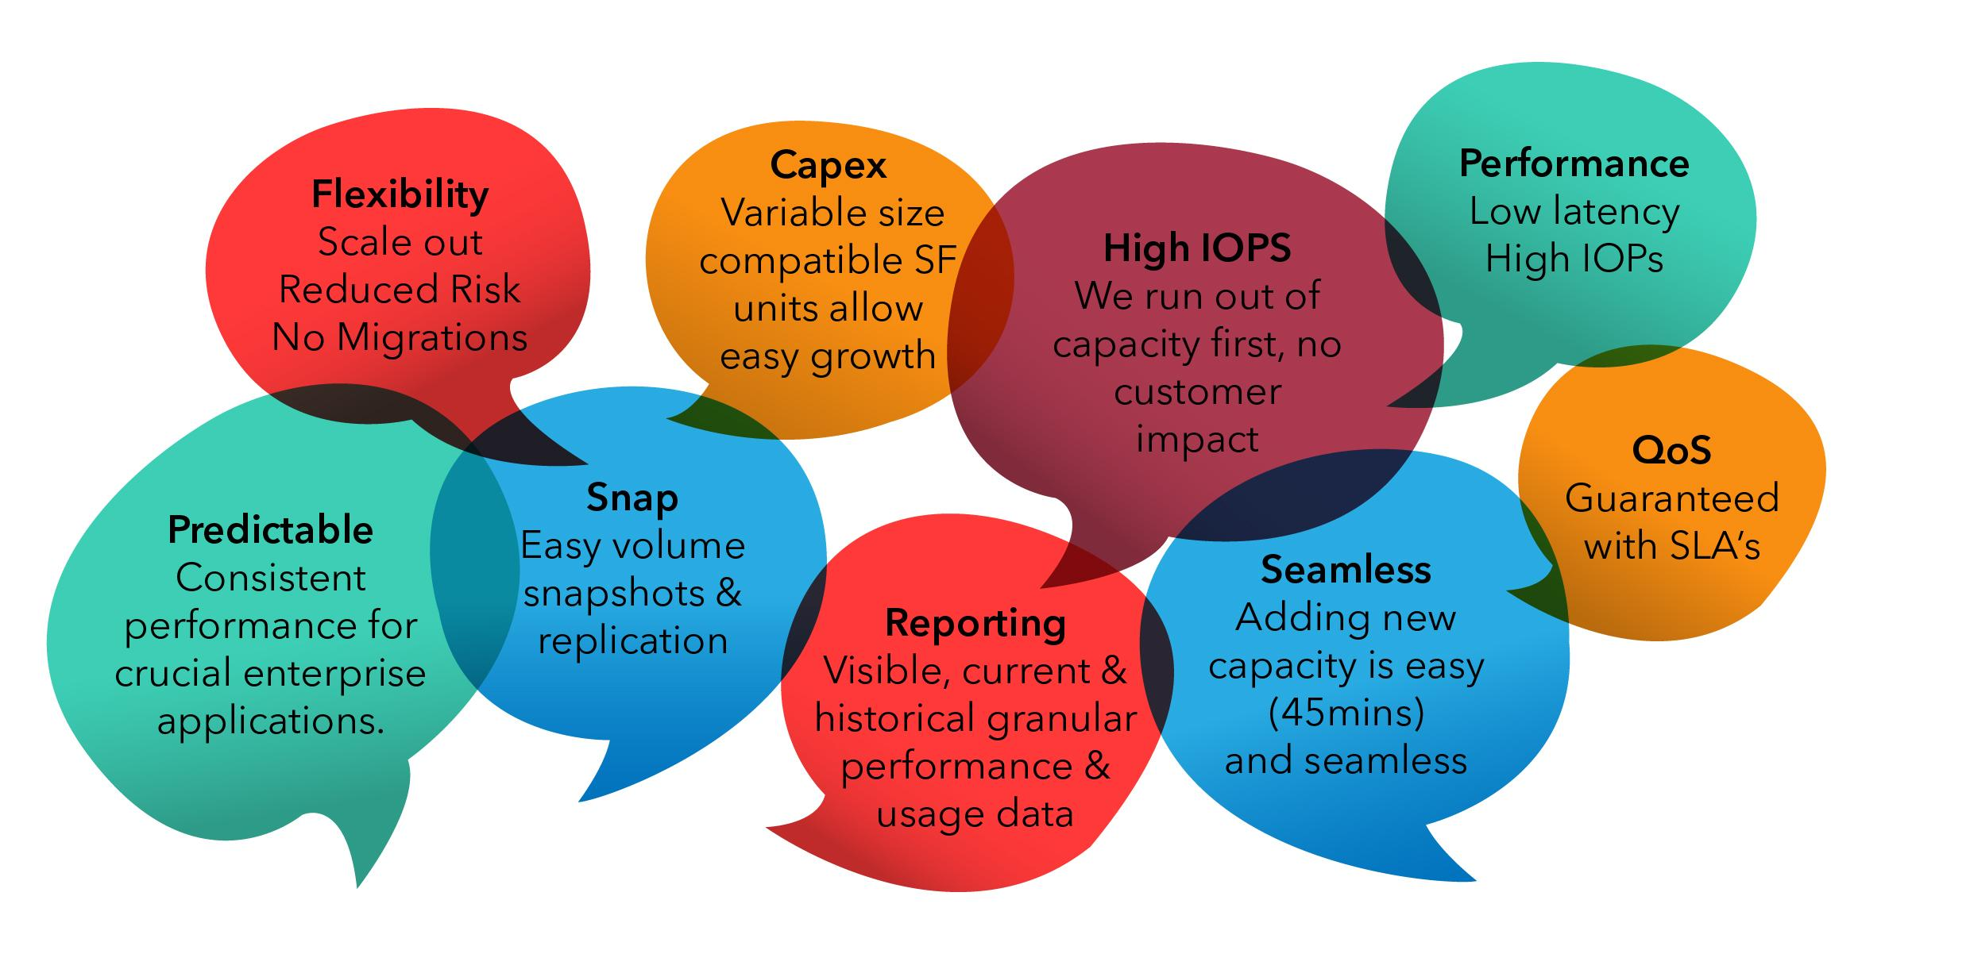
Why SolidFire
CONFIDENTIAL

Slide 15
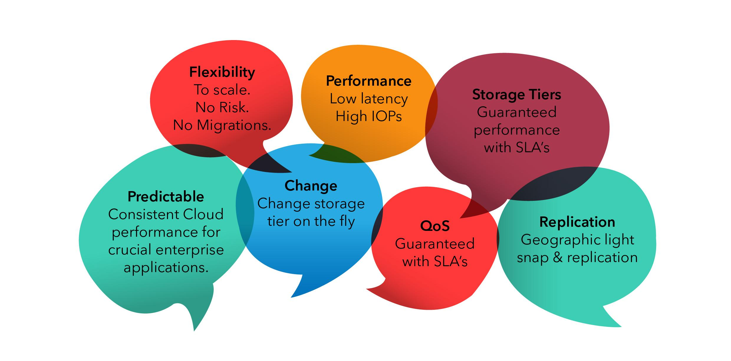
VDC Storage Value Proposition
CONFIDENTIAL

Slide 16
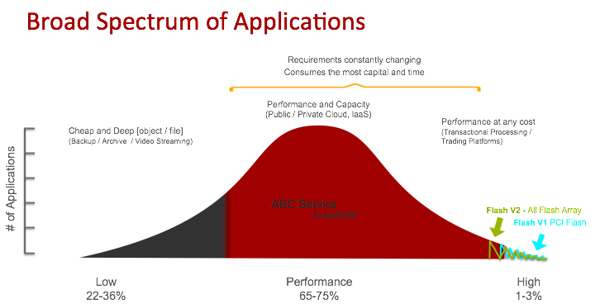
CONFIDENTIAL

Slide 17
Storage Tiers
Silver | Gold | Platinum |  | Custom Design
Web Servers, Non-Performant Applications, WordPress, Files, Magento, Vanilla, LAMP, MAMP | Basic eCommerce, Performance Web Servers, Low Performance database Servers | Production eCommerce,Performance Web Servers, Performance database Servers, MS Exchange, MS SharePoint, Analytics, Oracle ERP, SAP |  | High Performance eCommerce, Ultra-High Performance Web Servers, High Performance databases, Analytics, VDI, Virtual Datacenters, MS Exchange, MS SharePoint, Oracle, ERP, Large CRM, SAP
1 IOP / 10GB / m | 1 IOP / GB / m (guaranteed SLA) | 10 IOP / GB / m (guaranteed SLA) |  | 10+ IOP / GB / m (guaranteed custom SLA)
CONFIDENTIAL

Slide 18
Storage Tiers
Silver | Gold | Platinum | Custom Design (ICB)
~R3/GB/Mo | ~R7/GB/Mo | ~R12/GB/Mo | R14/GB/Mo Min
1 IOPS/ 10GB | 1 IOPS/GB (SLA Guaranteed) | 10 IOPS/GB (SLA Guaranteed) | 10+ IOPS/GB (SLA Guaranteed)
Min Volume 100GB | Min Volume 100GB | Min Volume 250GB | Min Volume 500GB
 | (Incl. micro-burst to 2x IOPS) | (Incl. micro-burst to 4x IOPS) | (Incl. micro-burst to 4x IOPS)
 | Highly Redundant | Highly Redundant | Highly Redundant
 | Easy upgrades to faster tiers | Easy upgrades to faster tiers | Custom Performance Availability
 | No downtime for maintenance | No downtime for maintenance | No downtime for maintenance
 | 256-bit AES at-rest encryption | 256-bit AES at-rest encryption | 256-bit AES at-rest encryption
CONFIDENTIAL

Slide 19
MSSQL on Platinum
Guaranteed Performance
All-flash architecture speeds database performance & reduces latency
Fine-grain Quality of Service guarantees performance to every database volume
Database Flexibility
Platinum storage is quick & easy to deploy and scale
Easily change database resources on the fly as business needs dictate
Scale granularly through the non-disruptive addition of new disks & volumes
Seamless Consolidation
Run tens to hundreds of Microsoft SQL Server databases on a single platform
Easily and predictably virtualize your Microsoft SQL Server environment
CONFIDENTIAL

Slide 20
MySQL on Platinum
Guaranteed Performance
All-flash architecture speeds database performance & reduces latency
Fine-grain Quality of Service guarantees performance to every database volume
Database Flexibility
Platinum storage is quick & easy to deploy and scale
Easily change database resources on the fly as business needs dictate
Scale granularly through the non-disruptive addition of new disks & volumes
Seamless Consolidation
Run tens to hundreds of MySQL Server databases on a single platform
Easily and predictably virtualize your MySQL Server environment
CONFIDENTIAL

Slide 21
VDI on Platinum
Adaptable Infrastructure
Go from pilot to production and beyond (no issues & no migration)
Design for X and change to Y on the fly
Size smaller environment and grow incrementally without redesign
Adjust QoS controls to accommodate boot storms, virus scans, patching and recompose operations
Eliminate Storage Sprawl
Extremely dense deployment with 1000+ desktops keeps footprint small
QoS eliminates need for a dedicated VDI storage
Efficiently leverage both linked clones and persistent full clones environment
CONFIDENTIAL

Slide 22
VDI on Platinum
Simplified VDI Administration
Drastically simplify storage management by removing VDI design complexity, streamlining desktop maintenance tasks and reducing administration time
Leverage known / existing desktop management tools
Speed up desktop provisioning and booting
Automatically balances desktops across the system
Provision more IOPs as required
CONFIDENTIAL

Slide 23

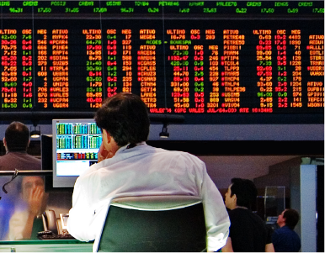
Moneyweb’s growth fueled by Enterprise Cloud
After researching a number of products available on the market, Moneyweb elected to partner with RSAWEB and to make use of their Enterprise Cloud product. Enterprise Cloud provides Moneyweb with a logically-isolated, private environment that is secure, cost effective, infinitely scalable and incredibly fast, guaranteeing sustained ‘IOPS’ (input/output per second).
Over the course of eight months, Moneyweb tested the usefulness of the virtual data centre and cloud environment, with the in-house development team working very closely with the team at RSAWEB to integrate the solution.
CONFIDENTIAL

Slide 24
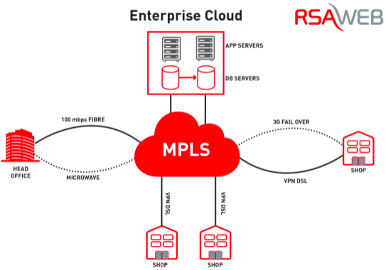
How does it fit in?
CONFIDENTIAL

Slide 25
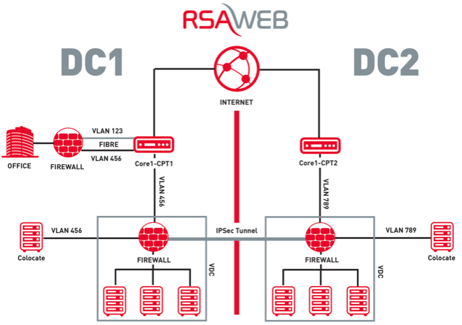
CONFIDENTIAL

Slide 26
Summary
Guaranteed Performance
All-flash architecture speeds database performance & reduces latency
Fine-grain Quality of Service guarantees performance to every volume
Suits Service Provider & Enterprise requirements
Easy to deploy & scale
Building blocks & not monolithic arrays
Multiple workload types
CONFIDENTIAL

Slide 27

THANK YOU
CONFIDENTIAL
Notes:
Get everyone to comment and add thier thoughts
Get each person to write down something on the brown paper that they believe will move the dial - then we frame that and it becomes our strategy canvas whihc we can put up in the support area.

Slide 28
