Slide 1
OUR CLIENT PROMISE
CIO Alliances
Customer Centricity Delivering Client Experience as an Output

Slide 2
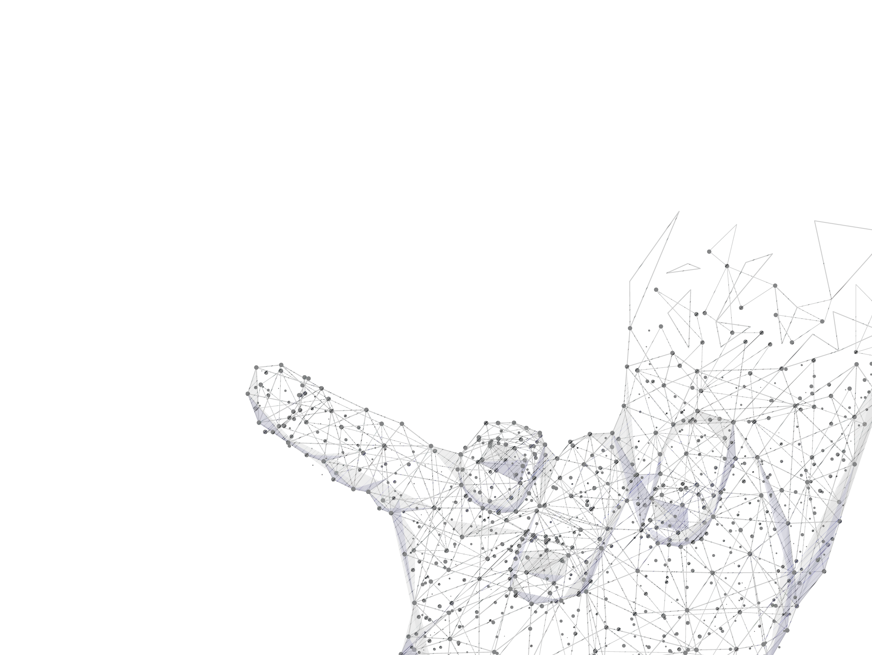
Holistic Approach to CX: Unique Competing Space
Macro-economic context
PESTEL
Industry/market context
Value Proposition
Competitor UCS
Client needs
Key Success factor analyses
Competitors’ offerings
Where the firm fulfils stakeholder’s & client needs in a way that competitors cannot
Where?
How?
Why?
What
Contested
Space
Unique competing space
Organizations competitive basis
Resources & Capabilities:
Valuable, Rare, Non imitable and transferable
Tovstiga, 2016

Slide 3
Making Customer Centricity Real: CX is an Outcome
Customer Centricity is a Way of Thinking that Translates to Adopting New Beliefs and Behaviors
Belief 1
Value of customers increases over time, while value of products or services, diminishes over time
Belief 2
Innovation requires new ways of doing things for and with the customer, not just incrementally improving products or services
Belief 3
Customer lock-on not lock in brings sustainable rewards
Belief 4
Personalize offerings since individuals and not markets lock on to a brand or enterprise
Belief 5
True value transpires when it lands in the customer’s space as an experience (while in our space create costs)
Belief 6
Customer Centricity needs to be significant not just successful, must have a higher purpose, contributing to human and planetary progress
(Adapted Van Der Merwe, 2016)

Slide 4
Staircase to Delivering Client Experience
Ease of doing business
Cognitive effort
Emotional effort
Physical effort
Transactional/consumption effort
Time effort
(Clark and Bryan, HCCM 2013)
Who else does this?
Deliver a memory
that sets us apart
Desire stay and advocate Organisation
Reliable experience at priority interactions
Consistent experience across any touch point
Experience
Inconsistent interactions across touch points
Loyal to Value Propositions
Desire to Partner with Organisation to Grow
Differentiated experience
Consistently reliable
Random experience
The “Quality of Trust”

Slide 5
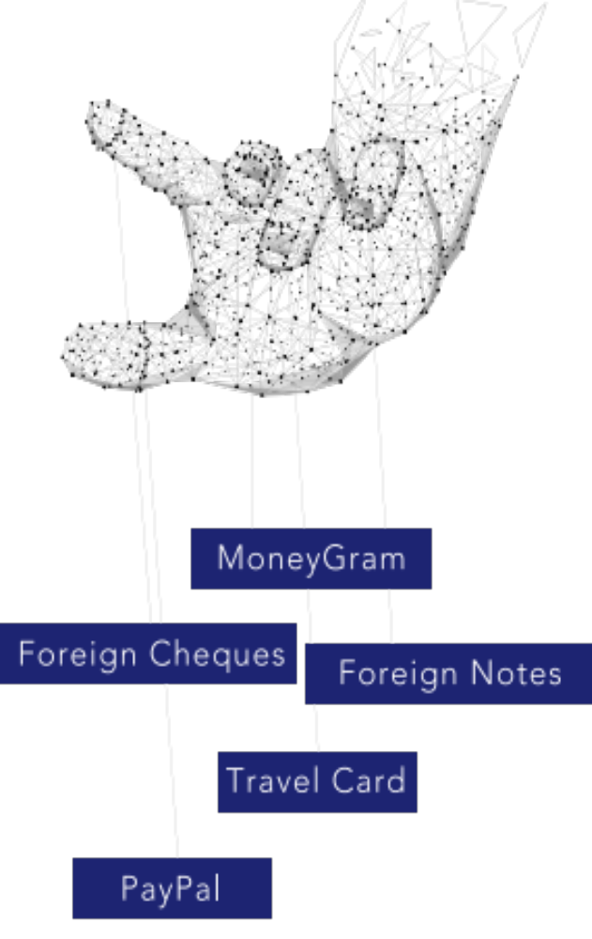
What Brings Value in the Clients: Value Gaps (adapted from Van Der Merwe)
Things not being done currently in this market space
Things being done badly by organisation for the client during their experience in this space
Things done by client that could do better or cheaper by someone else/by some other means
Create what the industry has never offered in this market space
Raise aspects in client activities well beyond industry standards
Value Creation

Slide 6
Considerations in approach
Research what the client wants
Gather voice of the client insights
Gather voice of the employee insights
Aborted transaction data/click stream data
Map the experiences of the client (and employee ) in their journey with you
  Identify Value Gaps (see next slide) in technology, process, people, capabilities, innovation, operating models, business models etc.
Client focus culture - Human centered and empathy driven culture
Change Capability to lead change inside out and outside in

Slide 7
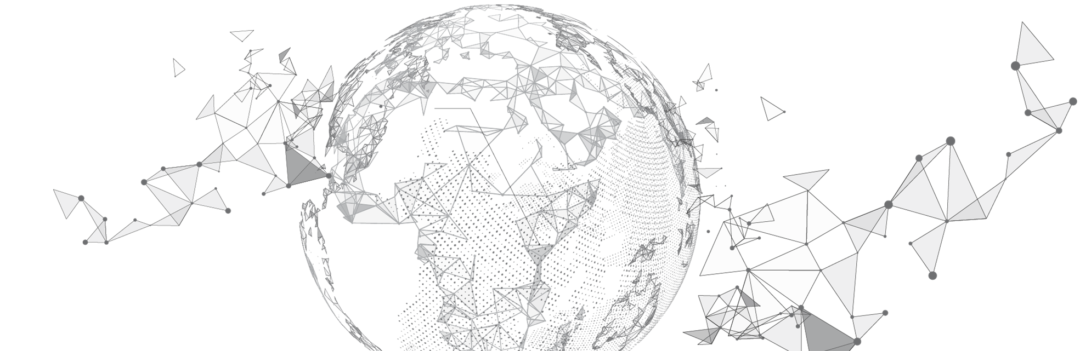
Drivers of client experience: Make it easy to be a client
B2B
Access to decision makers
Responsive company—quick to react
A contact point that is easy to get hold of
The company to really listen to me
An individualized approach to business
B2C
Information & explanation
Decision making help
Reassurance
Flexibility
Availability and access
Professional customer-contact representatives

Slide 8
Types of Measures
Depth of spend (quantitative)
Breadth of spend (quantitative)
Longevity of spend (quantitative)
Client lifetime value (quantitative)
Churn Models (quantitative)
Customer Effort Score (qualitative)
Net Promotor Score (qualitative)
Customer expectation (qualitative)

Slide 9
Customer Centricity Maturity Journey
Stage 4
Stage 3
Inspired by Customers
Stage 2
Engaged with Customers
Inspired by Customers: Develop new solutions to solve problems before customers ask
Stage 1
Responsive to Customers
Engaged with Customers: create an emotional bond that drives advocacy and Behaviour
Responsive to customers: Make improvements by acting on customers feedback
Targeted on Customers
Targeted on Customers: Sell more products and services to ‘best’ customers

Slide 10
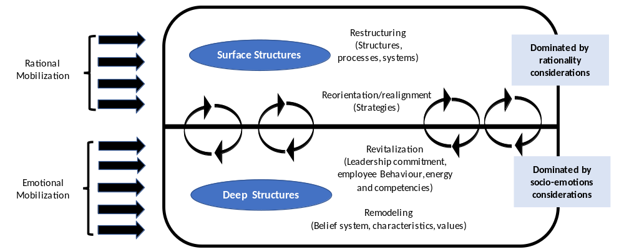
Paving the Way: Organizational Transformation
What does this mean for your business
What does this mean for your business
Adapted from Sattelberger, 1991 and Kruger, 1994

Slide 11
Social impact
CX maturity
(adapted from Bain, 2018)
Enable my business
to contribute
more to society
Support achieving
my organizations
purpose
Individual and
company promotional
value
(aspirational)
Enable social
impact
Help me differentiate
Make my business more marketable
Be my trusted advisor
Ease of
doing Business
(futuristic)
Make me marketable
Reduce anxiety
Personalized
Grow my business
Responsive
Functional
Value
(core)
Scenario planning
Reduce time effort
Expertise
New insights
Reduce cognitive
Service
Consultive
Reduce
costs
Quality
Table
Stakes
(non neg)
Up to date functionality
Accessible
Transparent
Reduce physical
effort
Motivational Factors Deepening Loyalty - Differentiate
Improve
top line
Price
fairness
Stability
Reduce
Risk
Communication
Compliance
Hygiene factors getting us on the playing field - Contested
Meet
specifications
Client
Locked in to our internal processes
Ethical
standards
Compliance

Slide 12
Preferred CX maturity
(adapted from Bain, 2018)
Social impact
Client “Lock on”
Social impact
Enable my business
to contribute
more to society
Support achieving
my organizations
purpose
Individual and
company promotional
value (aspirational)
Enable social
impact
Make my business more marketable
Help me differentiate
Be my trusted advisor
Ease of
doing Business
(futuristic)
Make me marketable
Personalized
Grow my business
Reduce anxiety
Responsive
Expertise
Scenario planning
Functional
Value
(core)
Reduce time effort
New insights
Service
Reduce cognitive
Consultive
Reduce
costs
Quality
Accessible
Table
Stakes
(non neg)
Up to date functionality
Stability
Reduce physical
effort
Transparent
Price
fairness
Motivational Factors Deepening Loyalty - Differentiate
Improve
top line
Reduce
Risk
Communication
Compliance
Hygiene factors getting us on the playing field - Contested
Meet
specifications
Compliance
Ethical
standards

