Slide 1
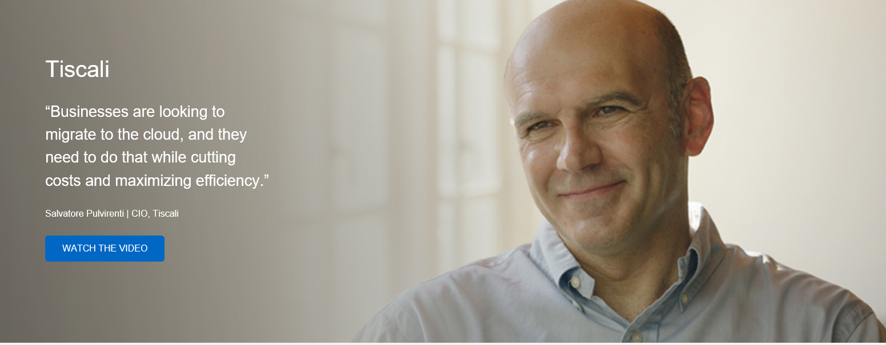
Tiscali Case Study

Slide 2
Tiscali: Brief
Who they are | Tiscali is delivering on a bold strategy to lead the Italian cloud services market. The only independent telecom operator in Italy is adding a portfolio of enterprise-class cloud services to its extensive list of consumer services.
What they did | The telecom grew quickly by offering phone and Internet access services. However, when the market rapidly shifted, Tiscali had to rethink its strategy. It pivoted quickly to break into the business-to-business (B2B) market with enterprise-class cloud services. To deliver that, Tiscali modernized its infrastructure with clustered Data ONTAP®. Through a Data Fabric enabled by NetApp®, the growing cloud service provider can innovate more quickly and provide customers with greater choice and control in the cloud.
Outcome | By modernizing its data center and laying the foundation for a Data Fabric enabled by NetApp, Tiscali has been able to: Offer zero-downtime service-level agreements Host multiple cloud services on a single, scalable storage platform Protect customers’ data with secure multi-tenancy capabilities Reclaim 50% of data center floor space and save 60% on power and cooling Support 30% annual data growth while cutting the IT budget by 50%
Epic Story | When market volatility forced Tiscali to rethink its strategy, the company pivoted to embrace a bold strategy with a Data Fabric that enables customers to maintain choice and control in the hybrid cloud.

Slide 3
Tiscali:
Delivering on bold business strategy with Data Fabric
“Integration between on-premises solutions and the cloud using a Data Fabric will be critical for success.”
Antonio Pittalis
IT Infrastructure Manager, Tiscali
Tiscali is Italy’s only independent telecom operator
Over its 17-year history, the company has maintained a vibrant culture of innovation and a clear vision for the future. The telecom grew quickly by offering phone and Internet access services. However, when the market rapidly shifted, Tiscali had to rethink its strategy. It pivoted quickly to break into the business-to-business (B2B) market with enterprise-class cloud services.

Slide 4
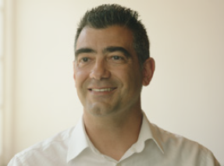
Unlocking the efficiency of the cloud
To lay the foundation for a Data Fabric, Tiscali modernized its data center with clustered Data ONTAP® and was able to:
Offer zero-downtime service-level agreements
Host multiple cloud services on a single, scalable storage platform
Protect customers’ data with secure multi-tenancy capabilities
Reclaim 50% of data center floor space and save 60% on power and cooling
Support 30% annual data growth while cutting the IT budget by 50%
“The scalability of clustered Data ONTAP helps us respond quickly to unknown needs. Today our business is not waiting on the technology.”
Antonio Pittalis
IT Infrastructure Manager
Tiscali

