Slide 1
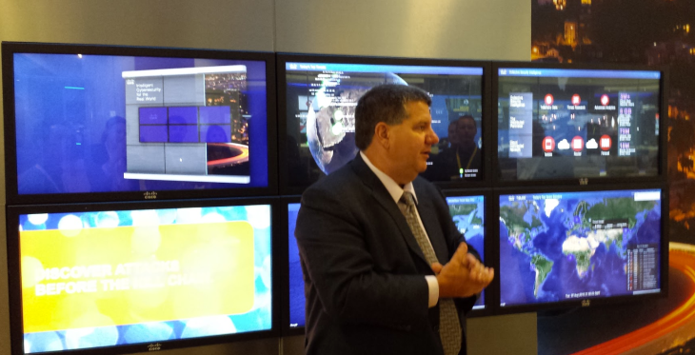
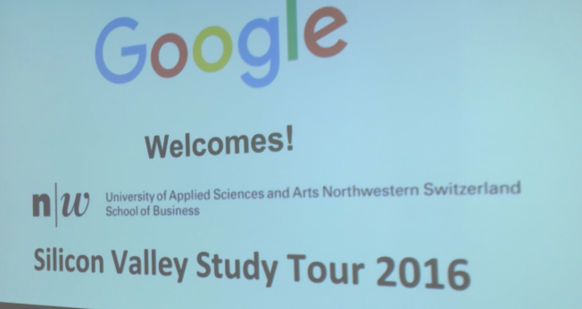
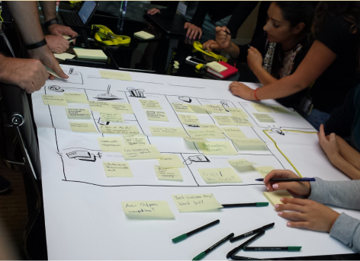
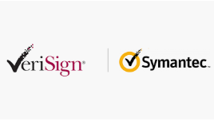
Intro

Slide 2
Disclaimer
Session prepared and presented in private capacity
My opinions don`t reflect on Truworths
Shared cases and experience depict solely my international background
No recording devices allowed

Slide 3
Buy-In
How to gain influence & Buy-in for Security investment from the Board?

Slide 4
Challenges for CISO`s
Disconnected communication channels
Conflicting agendas
Management “doesn`t seem to get it”
Putting out fires vs. strategic proposition

Slide 5
Ugly Truth
Only 22% of CISO`s report directly to the CEO¹
80% of Business leaders:
Cyber Security = technical/compliance routine²
74% of C-Suite executives agree CISO`s ≠ Board³

Slide 6
Usual remedy
FUD (Fear, Uncertainty & Doubt)
Compliance (GDPR,POPIA,PCI DSS, King IV)
….all too often it takes a breach….

Slide 7
Usual Perception
FUD = You always bring bad news = Bad News
GDPR/POPIA = You`re the compliance guy = Policeman
Breach = You weren`t able to protect us = Doubt
Notes:
Showing value rather than argument with fear when it comes to budget or policy decisions

Slide 8
Practical Resolutions

Slide 9
1. Putting out fires vs. strategic proposition
Find your cause.
Define your core principles.
3. Let your actions reflect your cause.
Source: «Start with Why» S. Sinek, 2009

Slide 10
1. Putting out fires vs. strategic proposition
Treat your Department as your own company.
Improve your business model
Source: Strategyzer (https://www.strategyzer.com/training/courses/mastering-business-models)

Slide 11
1. Putting out fires vs. strategic proposition
Understand your customer
Map your Value proposition
Source: Strategyzer (https://www.strategyzer.com/training/courses/mastering-value-propositions)

Slide 12
2. Management “doesn`t seem to get it”
Talk risk not Cyber Security
How well are you managing your risk posture?
Technical debt – ongoing analysis of legacy systems
Why certain risks where acceptable = business benefit
What is the governance structure?
How did you set up and manage security controls/tools
How are your preparing for the future?
How are your avoiding additional debts and deficits?
How are you enabling business?

Slide 13
2. Management “doesn`t seem to get it”
Make it «personal»
Phish your C-Suite (theoretically)
Social Media Do`s and Dont`s (privacy settings, etc.)
Develop security guides for home environment
parental control, ACL`s, MAC Address Filtering, etc.
Offer guidance on cloud services (e.g. Evernote)
Crash course in mobile security

Slide 14
3. Disconnected communication channels
Ignite the conversation
Create «CISO Lunch»
Quarterly Security Updates
Have your own Intra – Social – Media Channel
Coffee – Breaks with Marketing/Data-Analysts

Slide 15
3. Disconnected communication channels
TRUST
create long lasting positive business relationships
Control
Influence
Information
Elements of Trust⁵

Slide 16
4. Conflicting agendas
«If you can`t beat them – join them.»
Big Data
Cloud Security
Future Workplace (aka Digital Transformation)
AI/Machine Learning
Key Projects

Slide 17
Key Take Aways
Know what you are standing for (Value Proposition)
Research your customers‘ jobs, pains & gains match it with VP
Speak the language of your customer
Be your own twitter
Join the Team ☺

Slide 18
Thank You
Christine Fahlberg
IT Security Manager

Slide 19
What are the most common main objections you’re facing when trying to obtain buy-in?

Slide 20
Annex
Jody R. Westby (2015), Governance of cybersecurity: 2015 report, Georgia Tech Information Security Center
Deloitte CISO Labs data, 2015
ThreatTrack Security Inc., No respect: Chief information security officers misunderstood and underappreciated by their C-level peers, June–July 2014
World Economic Forum in collaboration with Deloitte, Partnering for cyber resilience: Towards the quantification of cyber threats, January 2015
ZAND, D. (1997). The Leadership Triad. Oxford University Press

